Slide 1
Viruses

Slide 2
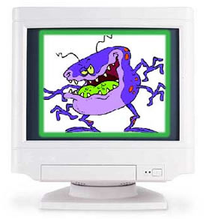

Slide 3
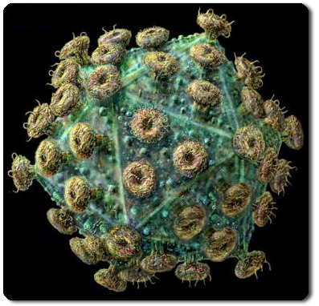

Slide 4
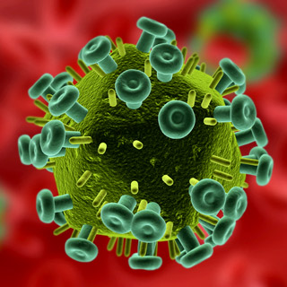
HIV Virus

Slide 5
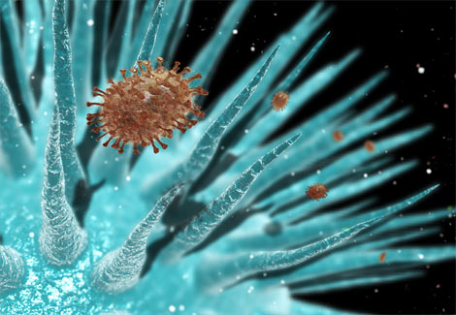
Flu Virus

Slide 6
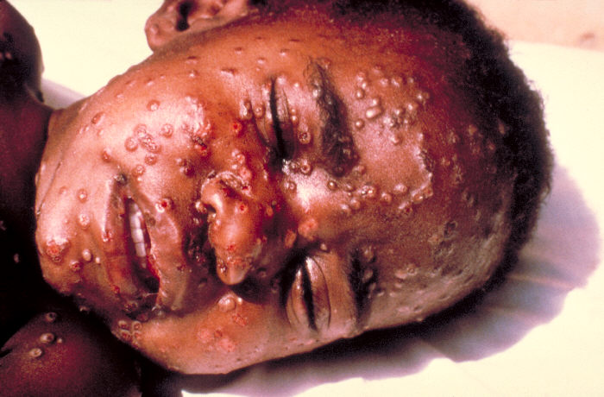
Smallpox Virus

Slide 7
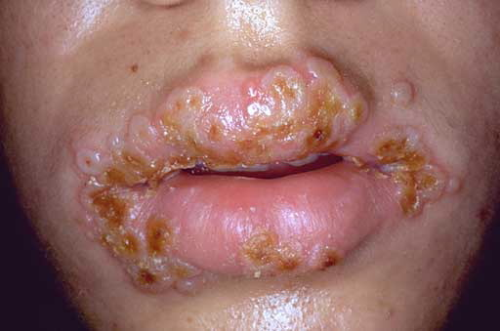
Herpes

Slide 8
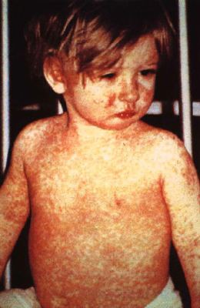
Measles

Slide 9
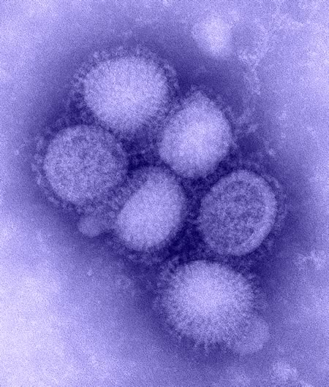
H1N1 (Swine Flu)

Slide 10
Is a virus particle alive?
Microscopic particle that can only reproduce within another living cell.
No other life functions
Do not fit into 5 Kingdom or 3 Domain models.
Measured in nanometers (one billionth of a meter).

Slide 11
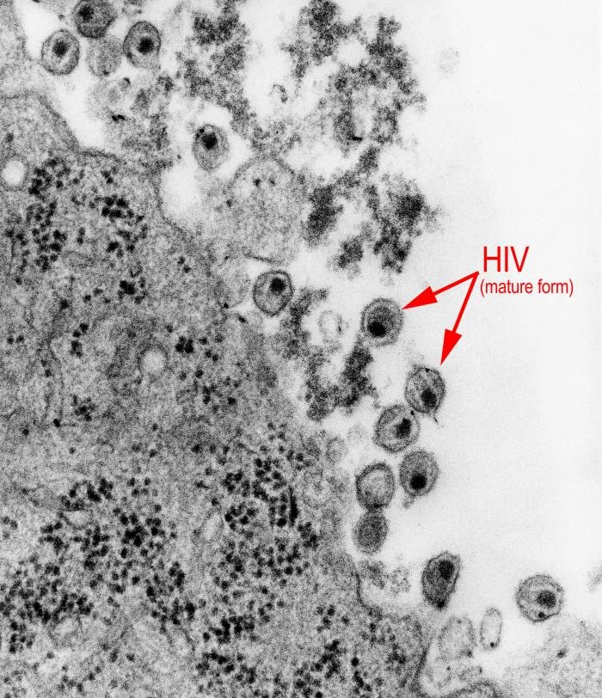
HIV emerging from human cell

Slide 12
Structure
1. Capsid – thousands of large protein molecules form an outer covering with a unique shape. (95% of the structure)
2. Strand – a single strand of DNA or RNA in the centre of the structure.
3. Envelope – some viruses have a lipid coating (from host cell)

Slide 13
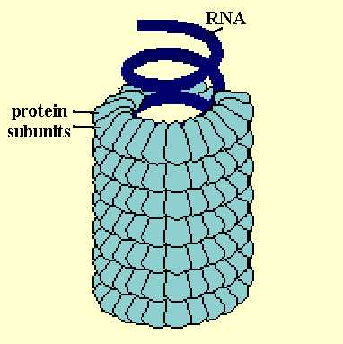
4 basic shapes
Helical. These are RNA viruses.
Ex: tobacco mosaic virus

Slide 14
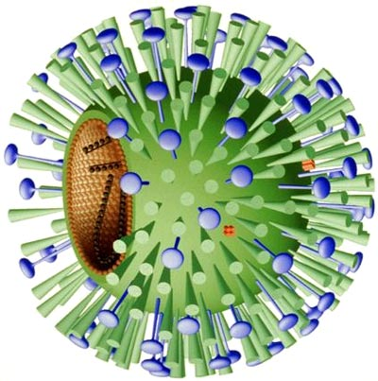
2. Disk. These are RNA viruses.
Ex: influenza virus

Slide 15
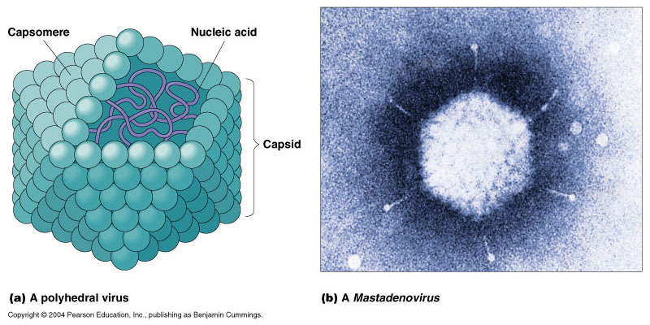
3. Polyhedral. These are DNA viruses.
Ex: an adenovirus (many cause colds)

Slide 16
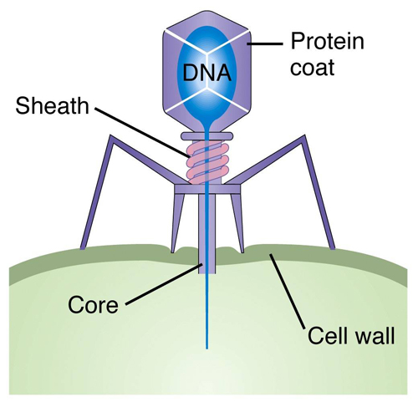
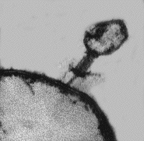
4. Complex. These are DNA viruses.
Ex: a bacteriophage (a virus that infects
bacterials cells)

Slide 17
Viral specificity
The capsid of a virus evolves over time to specifically match one cell type.
Ex: an adenovirus has a capsid that can only attach to the nasal cells of humans.
Ex: the tobacco mosaic virus can only attach to the cell wall of tobacco leaf plants.

Slide 18
This means that the range of hosts a virus can infect is limited.
Ex: H1N1 virus can only infect humans and swine.
Ex: rabies virus can only infect rodents, dogs, and humans.
Notice that these groups have a shared evolutionary history

Slide 19
This “lock and key” model is used to explain how viruses identify their hosts.
Proteins on the capsid lock in place with proteins on the outside of the host cell (these are called receptor sites)
Viruses have evolved this specificity over time. Some viruses (called RNA retroviruses) can evolve quickly enough to infect new host species.

Slide 20
Video Clips
Lytic Cycle
Lysogenic Cycle
Flu Attack

Slide 21
4 steps of viral replication
1. Recognition, attachment, and entrance.
2. Synthesis of protein and nucleic acids (DNA or RNA) by host cell.
3. Re-assembly of new virus particles.
4. Release of particles from host cells.

Slide 22
2 pathways of viral reproduction
1. Lytic cycle
2. Lysogenic cycle.

Slide 23
Defenses against viruses
Destruction of host organism will kill virus particles.
Non-specific: intact skin, mucous membranes, oil and sweat glands, beneficial bacteria.
Specific: phagocytic white blood cells, plasma proteins.
4. Medical: vaccines (smallpox, flu, etc), gene therapy?

Slide 24
Reducing infection rates
Hygiene: waste removal, sterilized needles, blood screening, barriers (condoms),…..HAND WASHING.
Immunization.
Reduce large scale ecological disturbances.
4. Quarantine: allows emerging viruses to die out through natural selection.

Slide 25
Beauty of Viruses clip

